Slide 1
Rotor Hub And Pitch System
Group Members :
Dhruvin Kakdiya
Adharsh Pappinisseri Veedu
Muthu Thirunavukarasu
Syed Mohammed Sikandar
Week number : 06
Date: 04/11/2025
Supervisor: Prof. Peter Quell

Slide 2
List of contents
  Hub Design
Adharsh Pappinisseri Veedu

Slide 3
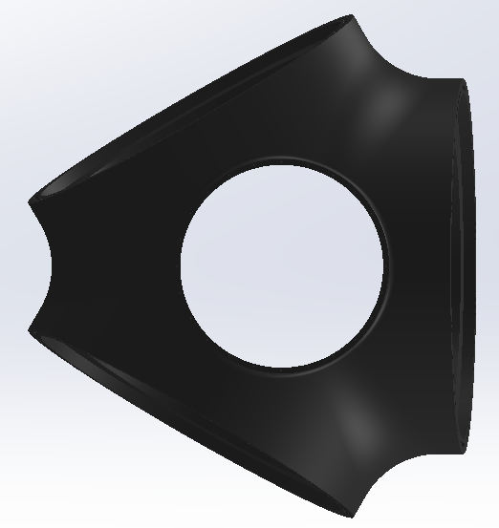

Hub Design
Front view: Own hub design
Back view
Adharsh Pappinisseri Veedu

Slide 4

Cone angle : 4’
Top view
Adharsh Pappinisseri Veedu

Slide 5
Bibliography
Optimus ocean design
Optimus shakti design
Adharsh Pappinisseri Veedu

